Slide 1
Summer Onboarding
Meeting #1
May 2024

Slide 2
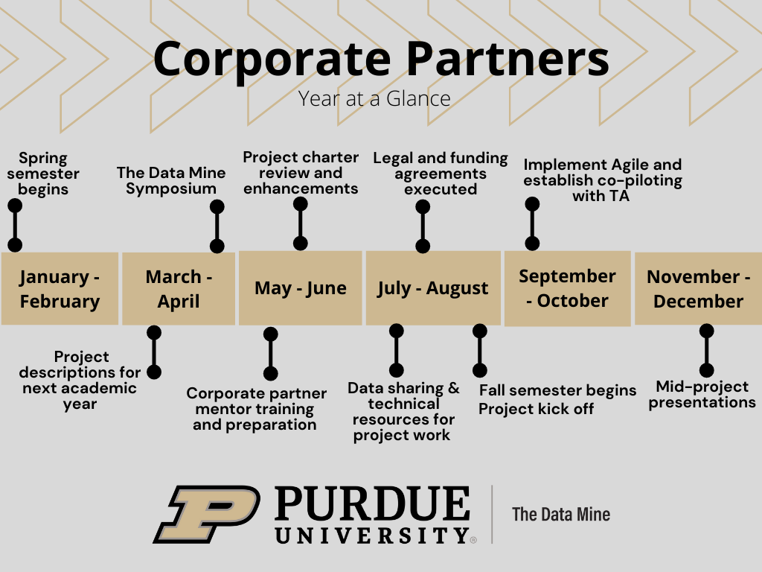
Year at a Glance
The Data Mine

Slide 3
Meeting Agenda
The Data Mine
Legal
Title IX Training
Project Charter

Slide 4
Legal
The Data Mine
Legal Documents
    Sponsor Acknowledgement (SA)
      [New Partners] Our industry partners sign this SA (click here to download full sponsor acknowledgement). The SA covers five years of partnership, but it does not obligate your company to five years of projects.
      [Renewing] After executing the full SA, please renew each year with this addendum for years two through five. (click here to download addendum).
    Nondisclosure Agreement (NDA)
      Most companies require the students and Data Mine staff to sign an NDA at the start of the project
      The NDA is provided by the company. If you do not have an NDA, here is a generic one provided by Purdue Legal Counsel. (click here to download NDA template).
      The NDA must be between an individual (student and staff) and the company. Purdue will not sign an NDA on behalf of the students.
      The Data Mine staff handles the logistics of getting the NDAs signed by students and staff. We return a zip file of all signed documents shortly after the fall semester starts.
    Intellectual Property (IP)
      At Purdue University, students retain their IP. Students can license their IP at no cost.
      The IP Assignment Agreement is provided by the company. If you do not have an IP Assignment Agreement, (click here to download IP Assignment template).
      Purdue faculty and staff cannot sign any agreement regarding IP for projects running under the SA. Faculty and staff can only sign an IP agreement under sponsored research contracts.

Slide 5
Title IX Training
All corporate partner mentors must complete the Title IX Mandatory Reporter Annual Certification.
Link to access the training: https://rise.articulate.com/share/iZxLOkuhvguWRDgucVLEsmTU2QgV2kwg?_ga=2.226536212.864048274.1715024650-1658901526.1704904023#/
Once training is complete, you’ll receive a confirmation email. Please forward that email to your corporate partner liaison.
The Data Mine

Slide 6
Project Charter
The Data Mine
The Purpose of the project charter is the inform the students what they are working towards and why it is important
With clear guidance and motivation, the students will take ownership and use their creativity to work on the project

Slide 7
Project Charter
The Data Mine
A Project Charter builds upon the project description by adding additional details to help guide the students during the academic year.
Project charters formats can consist of a word document or slide deck.
What to include in the project charter
  Information about the company
    What does your company do?
    History
    What is your team’s role in relation to the company?
  Information about the mentor
    Title & Job responsibilities
    Contact Information
    Availability
  Project Description
    A bit more detailed version of the initial project description
    What is the motivation?
    Who are the stakeholders?
    What is the purpose?
  Objective
    Contextualize the project
    What are the main goals?
    What is the projected product?
    What are the expected outcomes for the end of the academic year?
https://the-examples-book.com/crp/mentors/projectcharter

Slide 8
Project Charter
The Data Mine
What to include in the project charter (continued…)
  About the Data
    What data is being used and why is it important to the project?
    How will the students access the data?
    Any preprocessing done prior to students receiving the data?
    How is is currently used?
    How was it collected?
  Goals / Milestones
    Fall Semester Goals
      Sprint Goals (7 Sprints)
    Spring Semester Goals
      Sprint Goals (7 Sprints)
    Team Roles
      Mentor (Project Owner)
      TA (Scrum Master)
      Students (Developers)
        Sub teams?
    Reviewing Materials
      Videos
      Literature
      Articles
      News
      Project Examples
    Required Tools
https://the-examples-book.com/crp/mentors/projectcharter

Slide 9

Meeting #2 Agenda
The Data Mine
Data Sharing
Agile
Community Building
Goals

Slide 10
Thank You
datamine@purdue.edu

